Slide 1
Macro Economics
&
National Income Accounting
Samir K Mahajan

Slide 2
MACROECONOMICS
Macro Economic Theory
Theory of Income and Employment
Theory of Consumption
Theory of General Price Level and Inflation
Theory of Econmic Growth
Macro Theory of Distribution (Relative Share of Wages and Profits)
Theory of Trade or Business Cycles
Theory of Investment
Macroeconomics looks at the economy as an organic whole. Macro economics studies economic aggregates such as: total output, total demand, aggregate income, total savings, total investment, total employment, rise and fall in general price level, interest rates.
Samir K Mahajan

Slide 3
ECONOMY AND BASIC ECONOMIC ACTIVITIES
An economy is the system of earning livelihood (Brown). An economy is just a group of people dealing with one another as they go about their lives. Another more common definition: Economy is a system of four basic economic activities such as: production, consumption, investment and distribution of goods and services.
Basic economic activities production, distribution, consumption and investment are the vital process or necessary economic activities without which an economy cannot exist.
Production is transformation of inputs into output/finished products. It is creation or addition of utilities. We can not produce matter. Matters are free gift of nature. We make them more useful by transforming them into finished goods.
Consumption is use of goods and services. It is destruction or decrease in utility in a particular commodity.
Investment also called captain formation is the production of new capital goods. It is addition to existing capital stock of a society or economy. Investment is Excess of production over consumption which is used for further productive activities during an accounting period.
Distribution is the sharing of produced goods and services or aggregate income among the various owners of factors of production in the form of rents, wages, interests and profits.
Samir K Mahajan

Slide 4
Aggregate Output = Aggregate Factor Income = Aggregate Expenditure = Consumption + Investment
Samir K Mahajan

Slide 5
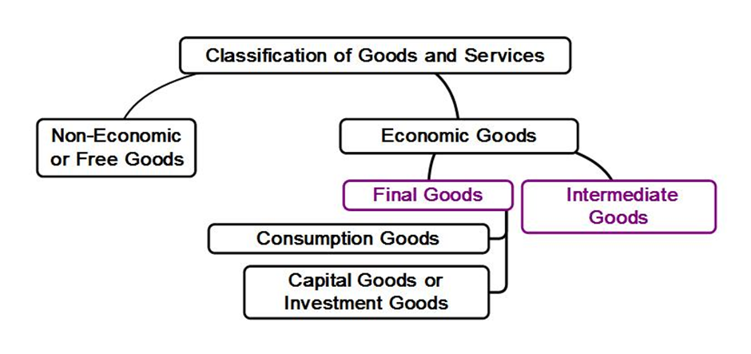
Classification of Goods and Services
Samir K Mahajan

Slide 6
Some Basic Concepts
Consumption Goods: Consumption Goods are goods and services used directly by individuals/households for satisfaction of wants.
Capital Goods/investment goods: Investment/capital goods are goods used in the manufacture of other goods. These are goods used for future/further productive activities such as roads, buildings, roads and bridges, transport equipments
Intermediate goods: Intermediate goods are goods that have to pass through further production process or meant for resale during an accounting year. These are goods meant neither for consumption nor for investment. e.g. raw materials, fuels, electricity etc. Intermediate goods are not considered in the calculation of national income.
Final goods: Final goods consists of consumption goods and investment goods. Final goods are considered in the calculation of national income.
Producer goods: Producer goods consists of capital goods and intermediate goods.
Samir K Mahajan

Slide 7
Some Basic Concepts
Concepts of Capital formation or investment:
GROSS DOMESTIC CAPITAL FORMATION : Gross Domestic capital formation is value of newly produced capital goods during an accounting year.
Thus, Gross Domestic Capital Formation = Gross Domestic Fixed Capital formation + Change in stock
Where , gross domestic fixed capital formation is the value of newly produced fixed capital goods i.e. assets within the country such as: roads, buildings, roads and bridges, transport equipments machineries and equipments.
Change in stock is the change in stock of inventories of raw materials, finished and semi-finished goods lying with the producers at the end of accounting year
NET DOMESTIC CAPITAL FORMATION= Gross Domestic Capital Formation– Depreciation
Where, Depreciation or Consumption of Fixed Capital is decrease in the value of fixed capital assets due to normal wear and tear out.
Samir K Mahajan

Slide 8
Some Basic Concepts
Export: Export is s ale of goods and services to foreign countries.
Import: Import is purchase of goods and services from foreign countries.
Net Export: = Export – Import
Saving : Saving is income not spent, or deferred consumption. Saving = Income –consumption
Net factor income from Abroad (NFIA) = factor income received from abroad – factor income paid to abroad.
Direct Taxes: Direct Taxes are taxes imposed on income and capital.
Indirect taxes: Indirect taxes are Taxes imposed on goods and services.
Subsidies: Subsidies are economic grants provided to certain cover up the losses suffered when cost of production is more than the market prices.
Net Indirect Tax = Indirect Tax – Subsidies
Transfer payments or non-factor income: Transfer payments are payments received without contributing anything to production process e.g. unemployment benefits, old-age benefits, taxes, windfall profits from speculation activities say lottery , pocket money, gifts etc.
Samir K Mahajan

Slide 9
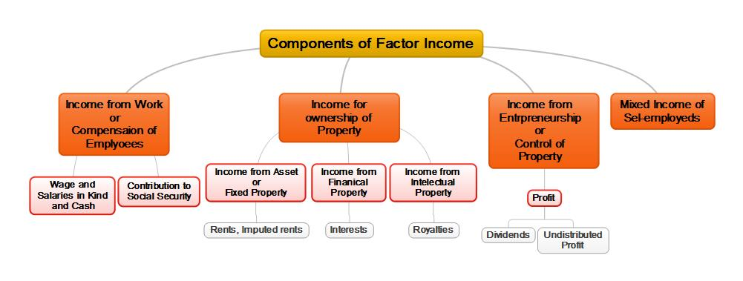
Some Basic Concepts
Factor Income: Factor incomes are the incomes generated and earned by the owners of factors of production. These includes wages, rents, interest, profits etc.
Samir K Mahajan

Slide 10
Producing Sector of the Economy :In order to determine the output of the economy , the economy is classified into three broad industrial sectors such as primary sector , secondary sector and tertiary sector.
Primary sector includes
Agriculture
Mining and quarrying
Fishing and Animal Husbandry
Secondary Sector which includes
Construction
Manufacturing
Tertiary sectors which includes
Transportation, communication, storage and other public utilities
Trade
Hotels and restaurants
Banking , insurance and finance
Professions and business services including accounting; software development; data processing services; business and management consultancy; architectural, engineering and other technical consultancy; advertisement and other business services
real estate and Ownership of dwellings
Public administration and defence
Other services including education, medical and health, religious and other community services, legal services, recreation and entertainment services
Some Basic Concepts
Samir K Mahajan

Slide 11
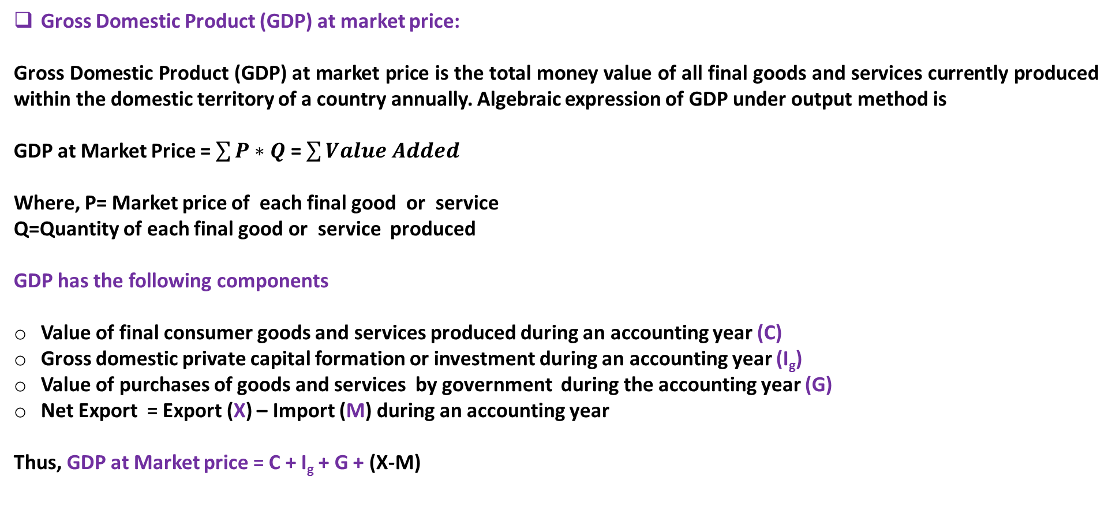
CONCEPTS OF NATIONAL INCOME
Gross Domestic Product (GDP) at market price:
Gross Domestic Product (GDP) at market price is the total money value of all final goods and services currently produced within the domestic territory of a country annually. Algebraic expression of GDP under output method is
GDP at Market Price = $\sum{P∗Q}$ = $\sum{Value Added}$
Where, P= Market price of each final good or service Q=Quantity of each final good or service produced
GDP has the following components
Value of final consumer goods and services produced during an accounting year (C)
Gross domestic private capital formation or investment during an accounting year (I_{g})
Value of purchases of goods and services by government during the accounting year (G)
Net Export = Export (X) – Import (M) during an accounting year
Thus, GDP at Market price = C + I_{g} + G + (X-M)
Samir K Mahajan

Slide 12
CONCEPTS OF NATIONAL INCOME contd.
Net Domestic Product (NDP) at market price:
Net Domestic Product at market price is the money value of all final goods and services produced within the country after providing for depreciation.
Algebraically, NDP at market = GDP at Market price – Depreciation
=C + I_{g} + G + (X-M) – D
= C + ( I_{g} – D )+ G + (X-M)
= C + I_{n} + G + (X-M)
Here, D is deprecation
I_{n} is net domestic capital formation or investment
Gross National Product (GNP) at market price:
Gross National Product at market price is total money value of all final goods and services produced annually in a country plus net factor income from abroad.
Thus, GNP at Market price = GDP at Market price + NFIA
= C + I_{g} + G + (X-M) + NFIA
Where, NFIA is net foreign income from abroad
Samir K Mahajan

Slide 13
CONCEPTS OF NATIONAL INCOME contd.
Net National Product (NNP) at market price:
Net National Product at market price is the money value of all final goods and services of a country after providing for depreciation.
Thus, NNP at Market price= GNP at market price – Deprecation
= NDP at market price + NFIA
= C + Ig + G + (X-M) + NFIA – D
= C + ( Ig – D )+ G + (X-M) + NFIA
= C + I_{n} + G + (X-M) + NFIA
Here, D is deprecation
I_{n} is net domestic capital formation or investment
Samir K Mahajan

Slide 14
CONCEPTS OF NATIONAL INCOME contd.
Domestic Factor Income or Net Domestic Product at Factor Cost
Domestic Factor Income or Net Domestic product at factor cost is the sum total factor income generated and earned by suppliers/owners of factors of production within the domestic territory of country during a year.
Domestic Factor Income or NDP at factor cost = Wages and salaries in kind and cash + contribution to social security
+ Rents including imputed rents + royalties + Interests
+ undistributed Profits + dividends
+ Mixed incomes of self-employed
National Income (NI) or NNP at Factor Cost :
National Income (NI) or NNP at Factor Cost is the sum total factor income generated and earned by suppliers/owners of factors of production in a country during a year.
National income or NNP at factor cost = Domestic Factor Income + Net factor income from abroad
= Wages and salaries in kind and cash + contribution to social security
+ Rents including imputed rents + royalties + Interests
+ undistributed Profits + dividends
+ Mixed incomes of self-employed
+ Net factor income from abroad
Samir K Mahajan

Slide 15
CONCEPTS OF NATIONAL INCOME contd.
Relationship between NDP at market price and NDP at factor Cost
Had there been no government intervention in the economy, both NDP at market price NDP at factor Cost would have been equal to each other. As the government interferes with the economy through imposition of indirect taxes on goods and services, and provision of subsidies to productive enterprises, these cause market prices of output to be different from the factor income resulting from it. Hence, there arises difference between NDP at market price and NI (NDP at factor cost).
In accounting sense,
NDP at factor cost - subsidies = NDP at market price – indirect taxes
NDP at factor cost = NDP at market price – indirect taxes + subsidies
= NDP at market price – net indirect tax
Similarly,
GDP at factor cost = GDP at market price - indirect tax + subsidies
NNP at factor cost = NNP at market price - indirect tax + subsidies
GNP at factor cost = GNP at market price – indirect taxes + subsidies
Samir K Mahajan

Slide 16
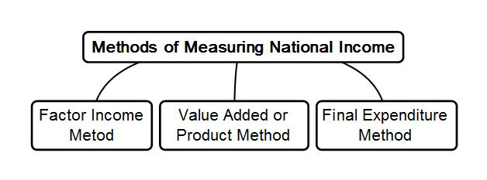
METHOD OF MEASUREMENT OF NATIONAL INCOME
Samir K Mahajan

Slide 17
METHOD OF MEASUREMENT OF NATIONAL INCOME
Value added Method or Product Method of Measuring National Income
Value added method adds up valued added by all productive sectors of the sectors of the economy annually. It measures final money value of all goods and services produced in a country during a year.
The mains steps involved in value method are as follows:
Step I: Identification and classification of production units located within the economic territories into three distinct industrial sectors on activity basis such as: primary, secondary and tertiary sectors. Final value of goods and services produced by these sectors are measured.
Step II: Estimation of Value Added by each production units in the industrial sector.
For this the following information are collected
Value of output
Intermediate consumption
Now, valued added = Value of Output – Intermediate consumption
Where , Value of output = Sales + Changes in stock+ Export
Intermediate consumption = Purchase of intermeddle goods fro domestic firms + imports of raw materials
Samir K Mahajan

Slide 18
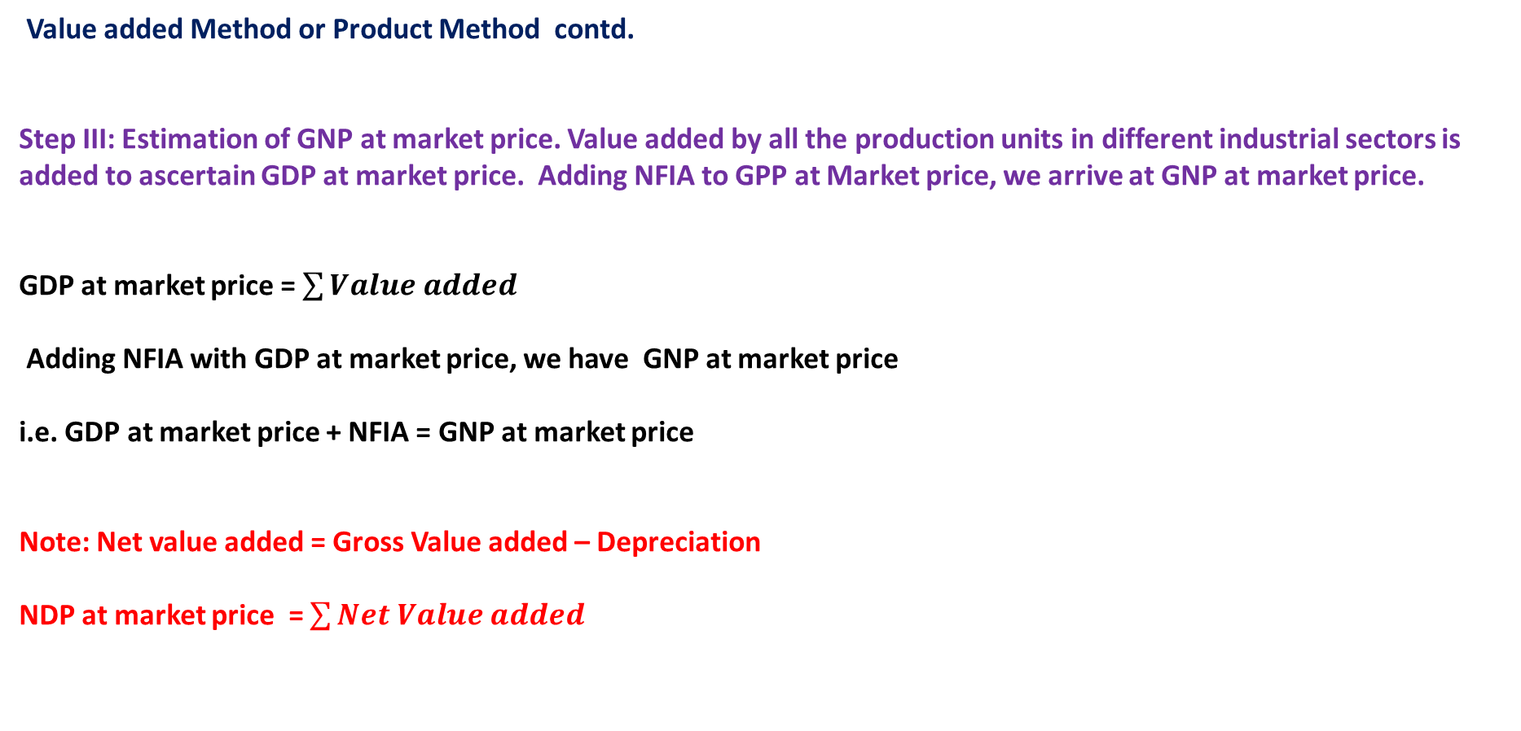
METHOD OF MEASUREMENT OF NATIONAL INCOME
Value added Method or Product Method contd.
Step III: Estimation of GNP at market price. Value added by all the production units in different industrial sectors is added to ascertain GDP at market price. Adding NFIA to GPP at Market price, we arrive at GNP at market price.
GDP at market price = $\sum{Value added }$
Adding NFIA with GDP at market price, we have GNP at market price
i.e. GDP at market price + NFIA = GNP at market price
Note: Net value added = Gross Value added – Depreciation
NDP at market price = $\sum{Net Value added }$
Samir K Mahajan

Slide 19
METHOD OF MEASUREMENT OF NATIONAL INCOME
Income Method of Measuring National Income
Income Method sums up all the factor incomes earned by suppliers /owners of factors of production annually. Factor of productions are engaged in production process and remunerated for their contribution.
The mains steps involved in production method are as follows:
Step I: Identification and classification of production units located within the economic territories into three distinct industrial sectors on activity basis such as: primary, secondary and tertiary sectors.
Step II: Classification of factor income earned by each factor separately in different sector of the economy. Factor incomes includes
income from work which includes wages and salaries in kind, contribution to social security
income form ownership which includes rents, royalties and interests
Income from control of property i.e. profits which includes dividends and undistributed profits
mixed incomes of self employed
net factor income from abroad ( NFIA)
Samir K Mahajan

Slide 20
METHOD OF MEASUREMENT OF NATIONAL INCOME
Income Method contd.
Step III: Estimation of National Income. Factor incomes paid out by each industrial sector are ascertained. Summation of factors income paid out by all the industrial sectors NDP at factor cost. By adding NFIA to NDP at factor cost, we arrive at national income.
i.e. NDP at factor cost Domestic Factor income= wages and salaries in kind and cash + contributions to social security
+ rents including imputed rents + royalties + interests + dividends
+ undistributed profits + mixed incomes
Adding NFIA with NDP at factor cost, we arrive at NNP at factor cost or national income.
i.e. NDP at factor cost + NFIA = NNP at factor cost or National Income
Samir K Mahajan

Slide 21
METHOD OF MEASUREMENT OF NATIONAL INCOME
Final Expenditure Method of Measuring National Income
Final Expenditure Method sums up expenditure incurred by different economic units on final output (final goods and service) of the economy annually.
The mains steps involved in final expenditure are as follows:
Step I: Identification and classicisation of economic units into household sector , producer sector, government sector and rest of the world sector.
Step II: Classification of final expenditure. Final expenditure are classified as
Final consumption expenditure by household sector
Gross domestic capital formation by producer sector
Government final expenditure
Net exports =Export –Import
Samir K Mahajan

Slide 22
METHOD OF MEASUREMENT OF NATIONAL INCOME
Step III: Estimation of Gross Domestic Expenditure (GDE) and Gross National Expenditure (GNE). Final expenditures are summed up to arrive at GDE . GDE is equivalent to GDP at market price.
Thus, GDE= GDP at market price = Private final consumption expenditure
+ Gross domestic private capital formation
+ Government final expenditure
+ Net Exports
Adding net factor income from abroad (NFIA) to GDE, we arrive at GNE or GNP at market price.
That i.e. , GNE = GNP at market price = GDE + NFIA
Samir K Mahajan

Slide 23
OTHER RELATED CONCEPTS
Aggregate Supply
Aggregate supply, also known as total output, is the total supply of goods and services produced within an economy at a given in a given period. It is a macro-economic term that describes the relationship between price level and the quantity of output that firms are willing to provide.
Aggregate Demand
Aggregate demand is an economic measurement of demand for the sum of all final goods and services produced in an economy in a given period. Aggregate demand is measured by market values. It's a macroeconomic term that describes the relationship between everything bought within a country and prices.
Aggregate Demand = Private final consumption expenditure
+ Private Domestic Investment Expenditure
+ Government expenditure on public goods and services
+ Net Exports
Samir K Mahajan

Slide 24
OTHER RELATED CONCEPTS
FORMS OF MONEY IN MODERN TIMES
In modern monetary transactions, In modern era, the total stock of money or money supply includes the following:
Metallic money or currency coins : Metallic money refers to the coins made out of metal like gold, bronze, silver, copper, nickel. Coins are of two types such as: Standard or Full-bodied Coins and Token coins.
Standard or Full-bodied Coins are those coins whose face value is equal to its intrinsic (metallic) value.
Token coins have intrinsic (metallic) value less than its face value. They generally are of lower denominations are made of cheap metals like nickel and copper. Token coins are used for exchange of small value.
Paper money or paper currency : Paper money consists of currency notes issued by the State Treasury or the Central bank of the country.
Credit or bank money: Bank demand deposits withdraw-able by issuing cheque has started functioning as money, and cheque are conventionally accepted as a means of payment by the business community in general.
Samir K Mahajan

Slide 25
OTHER RELATED CONCEPTS
Forms of money in modern times continued
In modern era, currency money and bank money together constitute the total stock of money or money supply.
Currency money (both currency coins and currency notes) is legal tender money or fiat money and has general acceptability.
Credit money or bank demand deposits are conventional money and lacks general acceptability.
Samir K Mahajan

